Slide 1
Models for handcycle Power output
Where are we now?

Slide 2
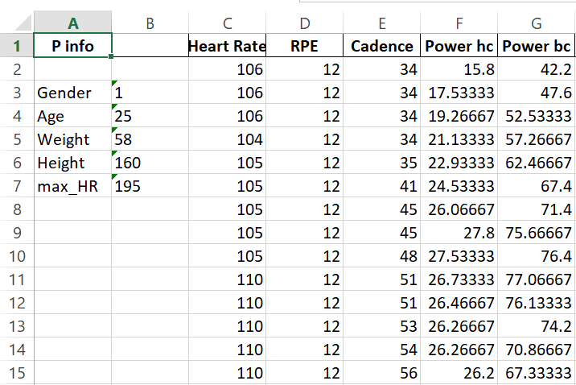
Input file: what was used?
Participants’ features
13 subjects, 4 females and 9 males
Average age: 25.07 years, between 21 and 32, with a standard deviation of 3.41 years

Slide 3
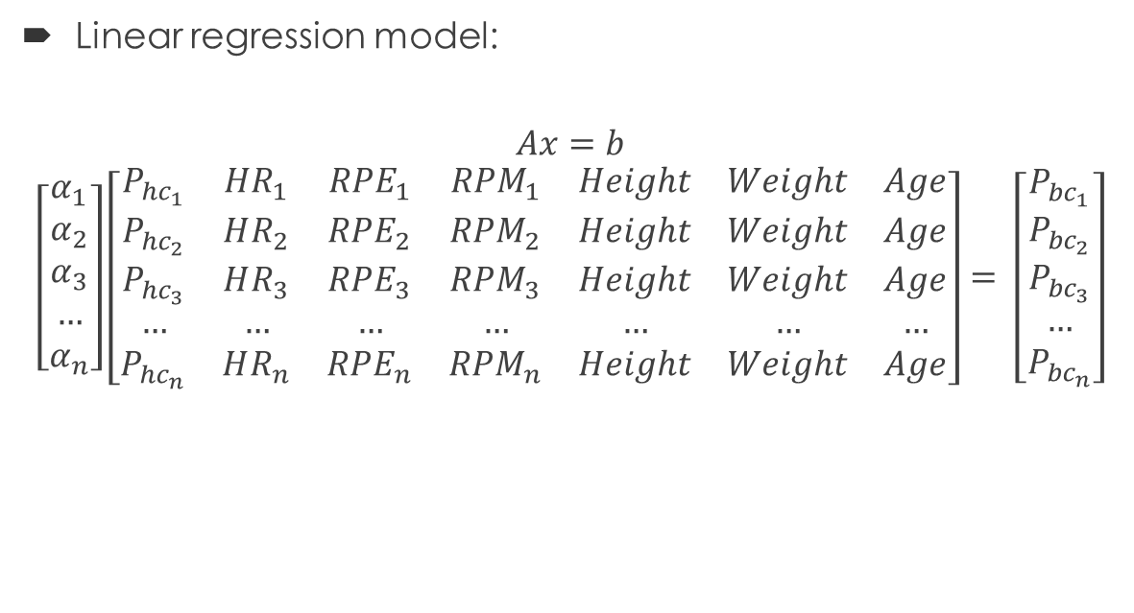

What models were used?
Linear model: α as a corrective factor
$$P_{bc}=α ∗P_{hc}$$
With
$$α=\frac{α_{1}+ α_{2}+ α_{3}}{3}$$
$$α=\frac{P_{bc, RPE}}{P_{hc, RPE}}$$
Linear regression model:
$$Ax=b$$
$$\left[\begin{aligned}α_{1} \\ α_{2} \\ α_{3} \\ … \\ α_{n}\end{aligned}\right]\left[\begin{matrix}P_{hc_{1}} & HR_{1} & RPE_{1} & RPM_{1} & Height & Weight & Age \\ P_{hc_{2}} & HR_{2} & RPE_{2} & RPM_{2} & Height & Weight & Age \\ P_{hc_{3}} & HR_{3} & RPE_{3} & RPM_{3} & Height & Weight & Age \\ … & … & … & … & … & … & … \\ P_{hc_{n}} & HR_{n} & RPE_{n} & RPM_{n} & Height & Weight & Age\end{matrix}\right]= \left[\begin{aligned}P_{bc_{1}} \\ P_{bc_{2}} \\ P_{bc_{3}} \\ … \\ P_{bc_{n}}\end{aligned}\right]$$

Slide 4
How was the model trained?
Trained on 11 participants, both female and male subjects, chosen randomly
3 subjects were witheld for testing the model as new, unseen data; this training set includes participant 14 who was excluded from the training as he complained pain in the shoulder probably linked to a previously received surgery and one female subject (subject 16)
RPE was first included as an input variable, but it will not be provided from Zwift users, so a second version of the model without RPE has also been tested on the same dataset to compare performances
- Note that the curve chosen as gold standard while evaluating the performances is the Power output on the bicycle, so the repeteability of the test is already compromised. A perfect overlapping of curves is not to be expected in any case.

Slide 5
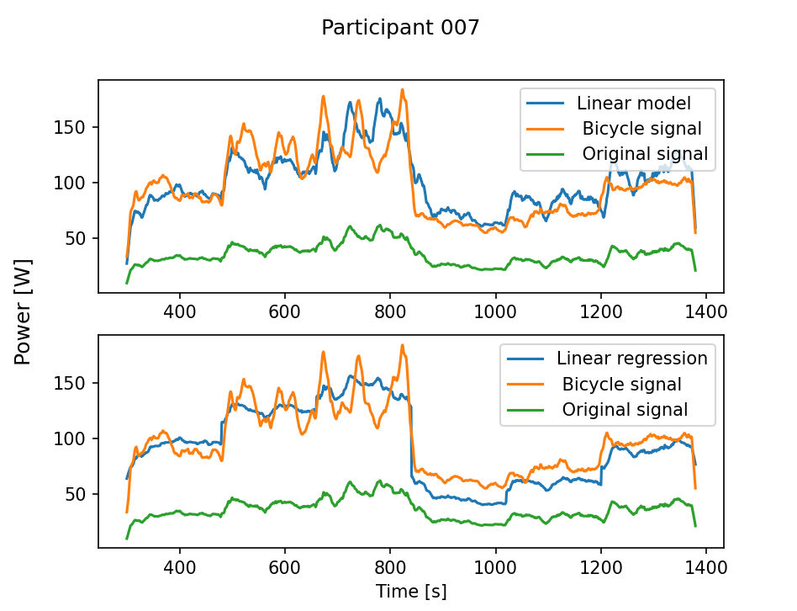
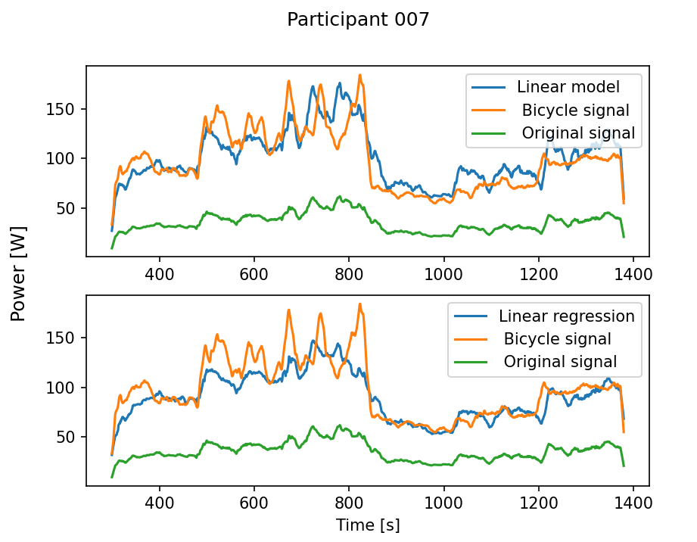
Comparing models: healthy, male participant
With RPE
Without RPE

Slide 6
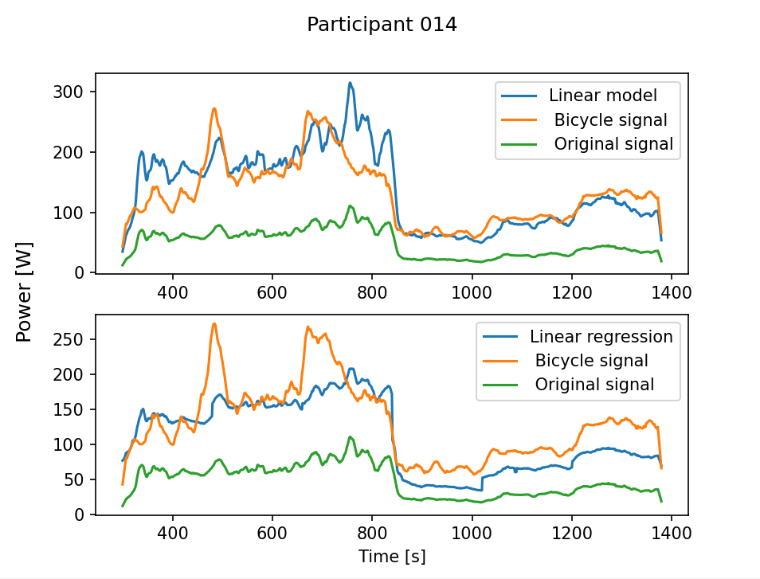
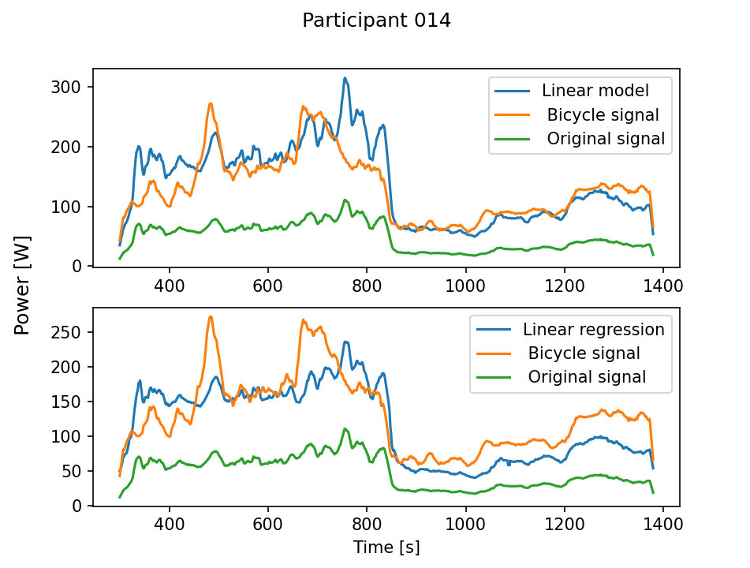
Comparing models: previously injured participant
With RPE
Without RPE

Slide 7
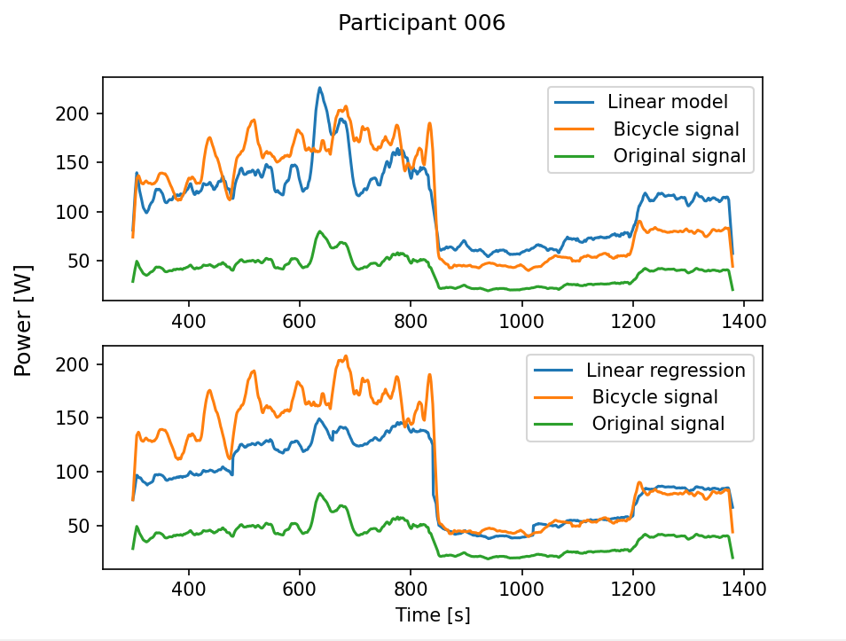
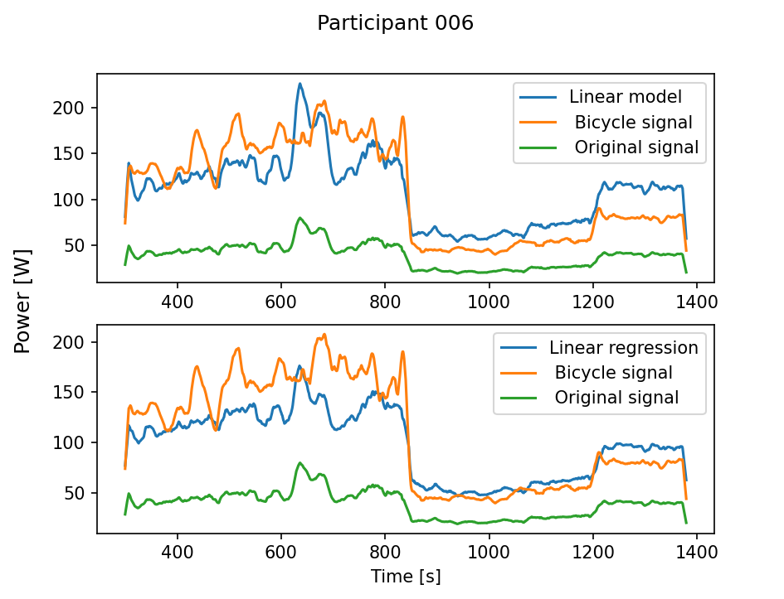
Comparing models: healthy, female participant
With RPE
Without RPE

Slide 8
Analysis of the model performances
The model seems to fit participants pretty well, even without RPE
-> Would it be possible to get a good output even without RPE?
Subject 14 seems to have a lower Power output, which is coherent with the fatigue in the shoulder the subject reported
Subject 6 (female subject) is the one who experienced a bigger difference between recorded and predicted power output
-> Would a gender-based model perform better?

Slide 9
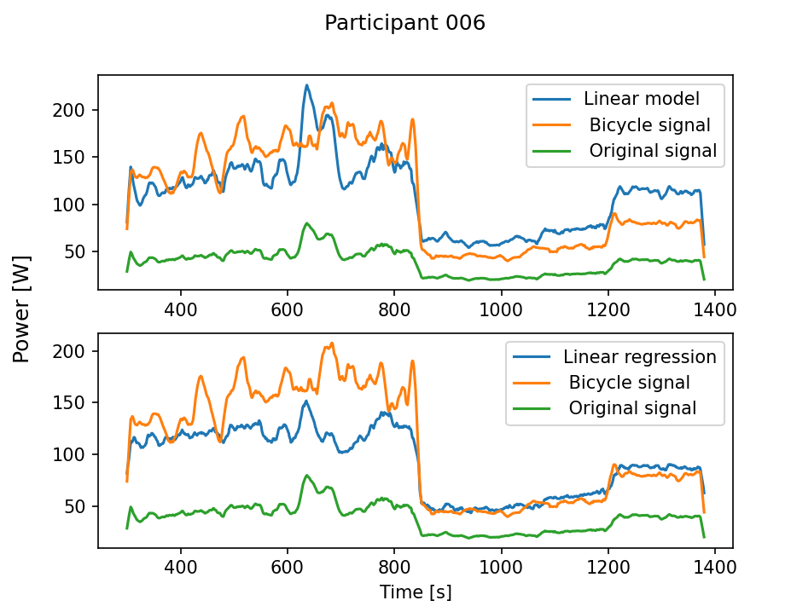
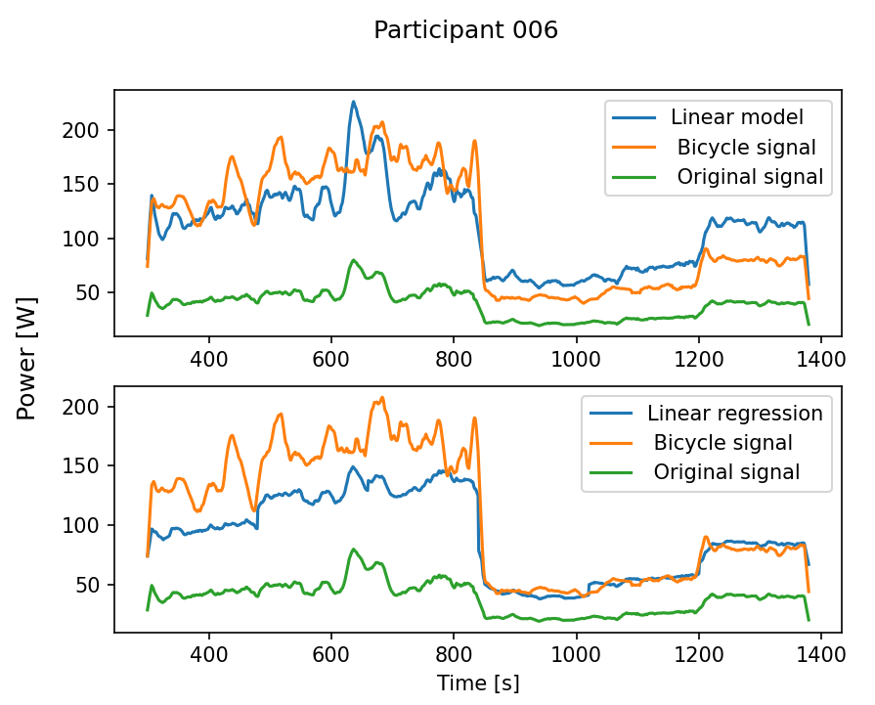
Gender-based model
All the female participants declared to be healthy and did not report previous injuries
Gender-based model
Mixed gender model

Slide 10
So what’s going on here?
The performance for the model based only on the female population doesn’t seem to improve the model noticeably. It may be due to the reduced size of the population
The linear regression model seems to be performing better, but it requires more testing on healthy subjects

